Slide 1
Design and Implementation of Dual- Band Reconfigurable Flexible Antenna for Wireless Applications.

Slide 2
OBJECTIVES
MIMO OFDM is a fast and efficient method of transmission of the data which suits the modern world demand. The entire process of data transfer involves a lot of small steps like IFFT and encoding.
A user is not always aware that what he should send and what he should not send.
The MIMO OFDM does not analyze the data architecture and puts it into transfer process. The proposed algorithm optimizes the process of data transfer and utilizes the channel well.
The proposed algorithm has been tested with three types of modulation techniques and two types of optimization techniques. The proposed algorithm has also used EBG to finally evaluate the optimized data through OFDM and MIMO.
The results section compares the bit error rate and mean square error under two situations, with and without proposed algorithm. The analysis of the results shows that the proposed algorithm has put a significant impact in decreasing both MSE and BER.

Slide 3
Motivation
Estimates the characteristics of the communication channel between the transmitter and the receiver.
The wireless channel can be affected by various factors such as:
Fading
Interference
Noise
which can degrade the quality of the signal received by the receiver.
In order to overcome the effects of these factors and improve the quality of the received signal, it is necessary to estimate the characteristics of the channel.
Orthogonal Frequency Division Multiplexing (OFDM) was designed in order to increase the data transfer rate in a channel while using EBG. Furthermore to cope up with the demand of the user, Multiple Inputs Multiple Output (MIMO) concepts were introduced to it .

Slide 4
LITERATURE SURVEY
AUTHOR | PAPER | INFERENCE | PROBLEM IDENTIFIED
Sai Huang; Meng Zhang; Yicheng Gao; Zhiyong Feng | MIMO Radar Aided mmWave Time-Varying Channel Estimation in MU-MIMO V2X Communications | In this paper, we propose a MIMO radar aided channel estimation scheme using deep learning (DL) for the uplink mmWave multiuser (MU)-MIMO communications. | Robust channel estimation in time-varying channels is used to guarantee the quality of communication services, especially for Vehicle-to-Everything (V2X) scenarios. To improve the channel estimation accuracy and reduce the pilot overhead,
Myung-Sun Baek , Member, IEEE, Sangwoon Kwak, Joon-Young Jung , Member, IEEE, Heung Mook Kim, Member, IEEE, and Dong-Joon Choi | A Supplementary Explanation for Experimental Environment of “Implementation Methodologies of Deep Learning-Based Signal Detection for Conventional MIMO Transmitters” | we proposed candidate implementation methodologies with simple verification experiments. According to this method it was shown that the proposed algorithms can achieve the optimal ML performance | The challenges for implementing deep learning-based algorithm in MIMO signal detector such as handling complex number or designing proper neural network for a specific communication system

Slide 5
AUTHOR | PAPER | INFERENCE | PROBLEM IDENTIFIED
Mingjie Shao , and Wing-Kin Ma , | Binary MIMO Detection via Homotopy Optimization and Its Deep Adaptation | In this paper we consider maximum-likelihood (ML) MIMO detection under one-bit quantized observations and binary symbol constellations. | Classical MIMO detection techniques consider unquantized observations, and many of them are not applicable to the one-bit MIMO case.
Carmen D’Andrea, and Erik G. Larsson, | Improving Cell-Free Massive MIMO by Local Per-Bit Soft Detection | In this paper, we consider the uplink of a cell-free Massive multiple-input multiple-output (MIMO) network where each user is decoded by a subset of access points (APs) | The non-linear processing at the APs consists of the approximate computation of the posterior density for each received data bit, exploiting only local channel state information only.

Slide 6
AUTHOR | PAPER | INFERENCE | PROBLEM IDENTIFIED
Zhiwen Wu; Hui Li | Stochastic Gradient Langevin Dynamics for Massive MIMO Detection | In this letter a MIMO detector with low computational complexity is proposed based on Stochastic Gradient Langevin Dynamics (SGLD). | The proposed detector estimates the modulated symbols through a non-convex optimization problem which is solved by SGLD based algorithm.

Slide 7
EXISTING SYSTEM
A frequency reconfigurable patch antenna design based on the characteristic mode analysis is presented. The antenna presents a reconfigurable lower band and a steady band at higher frequencies. A slot is etched on the ground plane of the antenna, where two varactor diodes are placed on each side of the slot in order to tune the lower band. The first resonant frequency shifts down by varying the reverse voltage of the varactor, whereas the second operating frequency keeps stable. The proposed antenna is designed to cover WLAN bands, offering a first band operating at 2 GHz and a second band ranging from 5.3 GHz to 5.8 GHz. A prototype has been fabricated and measurements are provided, which validate the proposed analysis, method, and design procedure.

Slide 8
PROPOSED SYSTEM
OFDM system channel estimation method is of two categories :
1.Blind Estimation and 2. Pilot-Assisted channel Estimation.
Blind Estimation :
the sent data is completely unknown.
This method allows transmitters do not have to send a special training sequence, it enhances the spectrum efficiency.
Pilot Assisted Channel Estimation :
To check whether the channel is free or not.

Slide 9
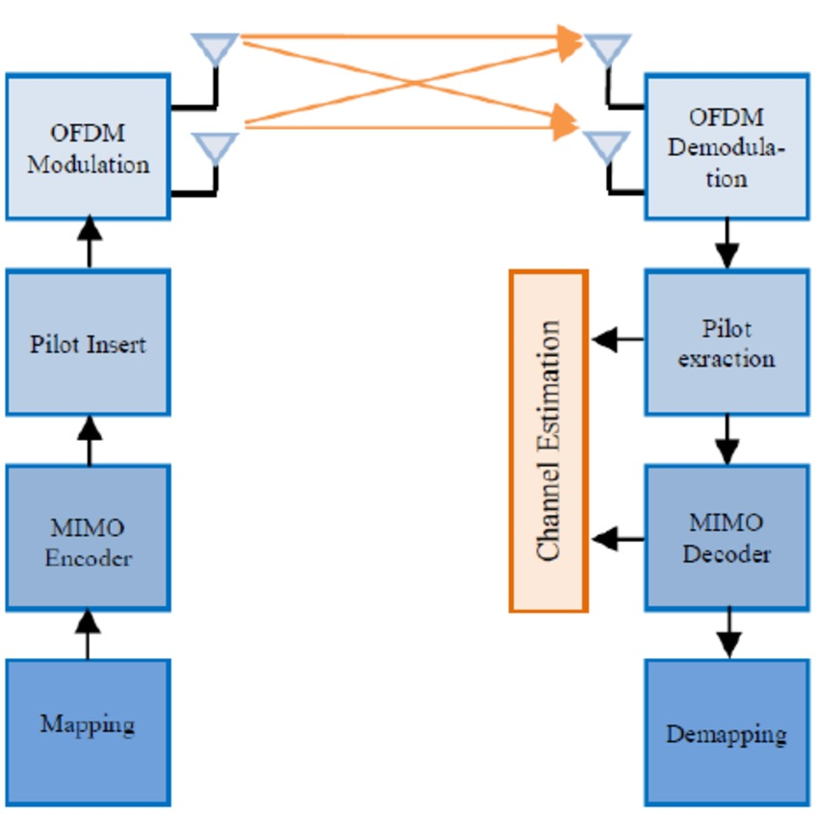
Proposed Block diagram

Slide 10
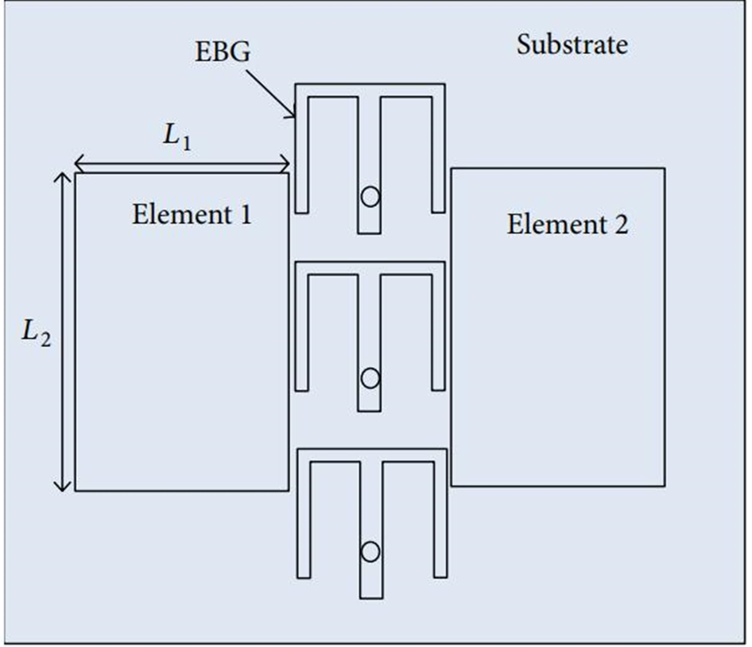
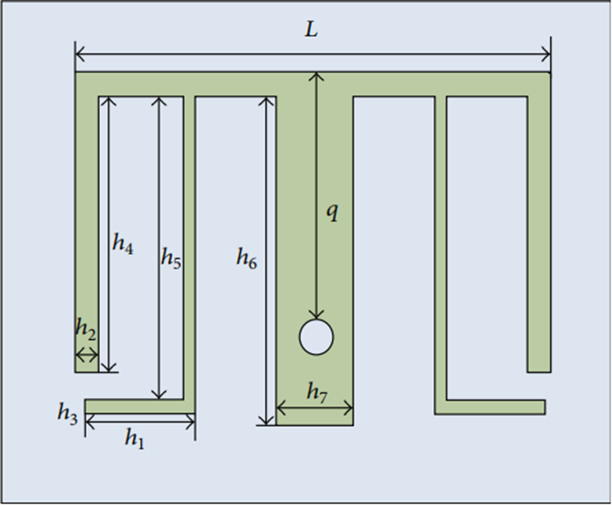
Antenna Structure

Slide 11
Components/Software required
Mathworks Matlab 2021a Tool

Slide 12
Scope of the project
It is necessary for upcoming wireless communication networks like 5G, 6G to work with better performance of MIMO - OFDM in order to overcome interference.
It helps the people to connect online uninterrupted.
This makes the people get the flow of internet connection.
It also helps the upcoming technology called “Metaverse”.

Slide 13
References
Bagadi, K. P., & Das, S. (2010). MIMO-OFDM channel estimation using pilot carries. International Journal of Computer Applications, 2(3).
R. S. Ganesh, J. Jayakumari and I. P. Akhila, "Channel estimation analysis in MIMO-OFDM wireless systems," (2011) International Conference on Signal Processing, Communication, Computing and Networking Technologies, Thuckalay, India, 2011, pp. 399-403,
doi: 10.1109/ICSCCN.2011.6024583.
Suzi Seroja Sarnin, Siti Maisurah Sulong, "Performance of channel estimation based on DD-EW RLS and NLMS for outdoor MIMO OFDM system", 2014 IEEE Conference on Systems, Process and Control (ICSPC 2014), pp.90-95, (2014).
J. A. Sam and A. K. Nair, "Analysis and implementation of channel estimation in OFDM system using pilot symbols," (2016) International Conference on Control, Instrumentation, Communication and Computational Technologies (ICCICCT), Kumaracoil, India, 2016, pp. 725-728,
doi: 10.1109/ICCICCT.2016.7988047.
Azizipour MJ, Mohamed‐Pour K. Compressed channel estimation for FDD massive MIMO systems without prior knowledge of sparse channel model. IET Communications. (2019) Apr;13(6):657-63.

Slide 14
References
Mário Marques da Silva, Rui Dinis, and João Guerreiro. "Implicit Pilots for an Efficient Channel Estimation in Simplified Massive MIMO Schemes with Precoding." EURASIP Journal on Wireless Communications and Networking 2019, no. 1 (2019): 27. doi: 10.1186/s13638-018-1306-4.
Mário Marques da Silva, Rui Dinis and João Guerreiro,(2020)A Low Complexity Channel Estimation and Detection for Massive MIMO Using SC-FDE, Instituto de Telecomunicações, 1049-001 Lisboa, Portugal, 24 January 2020; Accepted: 9 March 2020; Published: 14 March 2020.
Carrera, D. F., Vargas-Rosales, C., Azpilicueta, L., & Galaviz-Aguilar, J. A. (2020). Comparative study of channel estimators for massive MIMO 5G NR systems. IET Communications, 14(12), 2009-2017.
Zhang, Z., Zheng, Y., Gan, C., & Zhu, Q. (2020). Massive MIMO CSI reconstruction using CNN-LSTM and attention mechanism. IET Communications, 14(14), 2279-2286.
Saraereh, O. A., Khan, I., Alsafasfeh, Q., Alemaishat, S., & Kim, S. (2020). Low-Complexity Channel Estimation in 5G Massive MIMO-OFDM Systems. Electronics, 9(4), 559.
Immanuvel, A., Arulanantham, D., Kumarganesh, S., & Saranya, S. (2020). Performance analysis of channel estimator with interference detection architecture. International Journal of Electrical and Computer Engineering (IJECE), 10(6), 6576-6585.

Slide 15
References
Lemayian, J. P., & Hamamreh, J. M. (2021). Massive MIMO Channel Prediction Using Recurrent Neural Networks. IEEE Access, 9, 135754-135764.
Kumar, M. R., Prasanna, J. L., Alagarsamy, A., Pravallika, T. M., Jyothsna, K., Sindhuja, P. H., & Santhosh, C. (2022). Estimation of bit error rate in 2×2 and 4×4 multi-input multi-output-orthogonal frequency division multiplexing systems. International Journal of Recent Technology and Engineering, 9(3), 5298-5304.
Yan, L., Wang, Y., & Zheng, N. (2022). 5G Massive MIMO Signal Detection Algorithm Based on Deep Learning. Wireless Communications and Mobile Computing, 2022, 1-11.
Polireddi sireesha, “Channel Estimation for Massive MIMO Systems”,International Journal for Research in Applied Science & Engineering Technology (IJRASET) ISSN: 2321-9653; IC Value: 45.98; SJ Impact Factor: 7.538 Volume 10 Issue I Jan 2022.

Slide 16
QUERIES

Slide 17
THANK YOU

